Slide 1
MOVIE RECOMMENDATION SYSTEM
Home
About me
What I do
My experience
My work
Here is where our presentations begins

Slide 2
Problem Definition
Home
About me
What I do
My experience
My work
This project involves building a semi-realistic recommendation system for movies that can provide personalized recommendations to users based on their initial set of preferences.
Users will be provided a set of 20 movies the user have to select their ordered preference out of those movies that they would like to watch. Their preferences may represent the genre they are interested in watching. We would then recommend 5 movies out of those preference that match them best.

Slide 3
RECOMMENDATION SYSTEM:WHY?
Home
About me
What I do
My experience
My work
Information Overload: From a plethora of commodities user may not exactly know what to consume but can be suggested.
Is Productive: Eliminate the need to search for items.
Are efficient: Their outcomes are pretested, hence more chances to satisfy user need than a manual search.
Commercially Viable: For businesses help to keep the consumers hooked.
Based on history can be useful to forecast outcomes of to be launched products.
Can be useful to predict user specific traits.

Slide 4
RECOMMENDATION SYSTEMS
Content Based Filtering
Collaborative Filtering
Leverages item similarity and item attributes to recommend similar items to what a user liked before.
Leverages item user interaction to predict set of items based on similar user item interaction.
Home
About me
What I do
My experience
My work

Slide 5
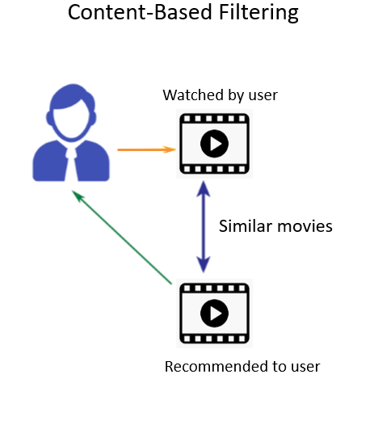
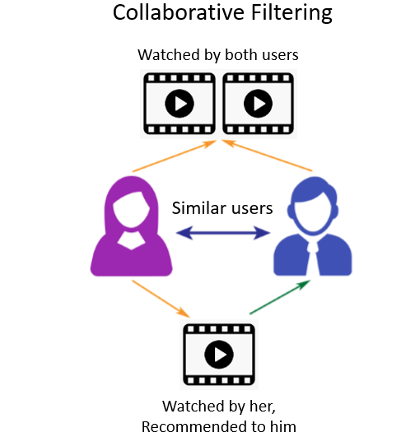

Slide 6
Perks of one system over other
Today, most commercial recommender systems use a hybrid approach to recommendation.
CBF: Requires to store item attributes, does not require any information about user item interaction.
CF: Computationally and storage expensive as requires to calculate and store user item interaction matrix. Underrated items gets skipped. But does not require to store item attributes.

Slide 7
Movie Recommendation system based on Content Based Filtering
Home
About me
What I do
My experience
My work

Slide 8

Introducing Movies.GPT
AI to help kill boredom
🚨CinematicAI
A model trained to suggest movies based on input from user. All you need to do is to enter your ordered preferences the model searches the database to predict 5 movies that best suit your interests according to your preferences.
Movies.GPT

Slide 9
Work-Flow
Dataset preparation
Pre-Processing
Stemming
Vectorization
Recommendation method

Slide 10
Data-set Preparation
Pre-Processing
Home
About me
What I do
My experience
My work
Imported two data sets, tmdb_5000_credits.csv, tmdb_5000_movies.csv and cleared unwanted data like budget, homepage, original_language, original_title, popularity, and we merged two datasets into a set “movies” which has movie_id, title, overview, genres, keywords, cast, crew data.
Removed Null values
Feature Selection
Made functions to convert features into required format
Concatenated all the necessary features into a single tag

Slide 11
Stemming
Home
About me
What I do
My experience
My work
Stemming is a process of reducing a word to its base or root form.
The PorterStemmer class from the nltk library to perform stemming on the 'tags' column of the 'movies' dataset.
applied the stem() function to every text value in the 'tags' column, which reduces the variations of the same word and helps to improve the accuracy of text analysis tasks such as text classification or sentiment analysis.

Slide 12
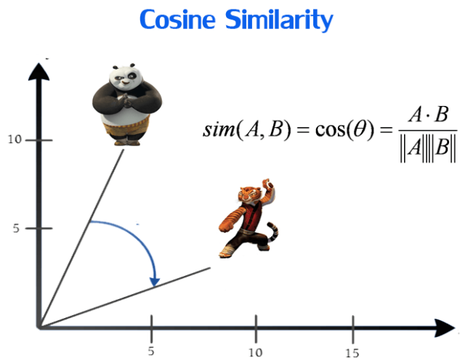
Vectorization & Cosine Similarity
We concatenated all the tags of 5000 movies and made a string, from that we took most repeated 5000 words into consideration and from every tag of every movie we check whether the word is present or not, from that we get a matrix of 1x5000 of 5000 movies. Now each matrix is converted to a Vector. Cosine similarity is a measure of similarity between two non-zero vectors of an inner product space. In the context of recommendation systems, cosine similarity is often used to compare the similarity between two items based on their features.

Slide 13
Recommendation Method
Home
About me
What I do
My experience
My work
Taking list of movie titles as input and recommend similar movies based on their similarity scores.
The method takes a movie title as input, fetches the index of the movie in the 'movies' dataset, and checks for similarities between the movie and all other movies from the Similarity matrix we have created before and returns the top 5 movies with the highest similarity scores.
The function avoids recommending movies that are already present in the input given by user to avoid duplication of recommendations.

Slide 14
FUTURE SCOPE

Slide 15
CAST
01
PRANAV RATHOD
02
MANPREET SINGH
03
BALU KARTHIK RAM
04
PRASHANT KUMAR
01
02
201100143
20110109
03
04
20110036
19110075

Slide 16

Life is too short to waste time on bad movies.
Let our movie recommendation system help you find the good ones.
Home
About me
What I do
My experience
My work
Thank You

